Slide 1

VIRTUAL
USER
EXPERIENCE
Be smart, be a VUX

Slide 2

Smart Building UX is not smart yet

Slide 3
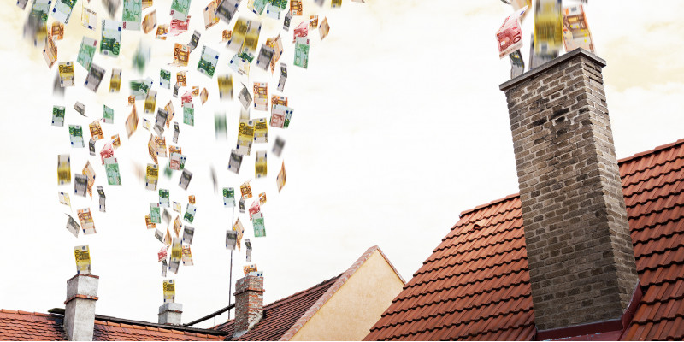
35%
of energy consumption
30%
of CO2 emissions
75%
of buildings are inefficient

Slide 4
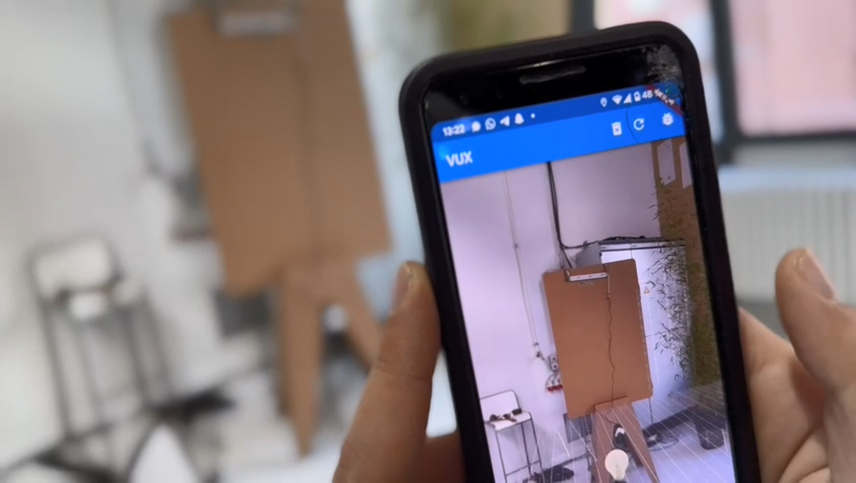

Slide 5
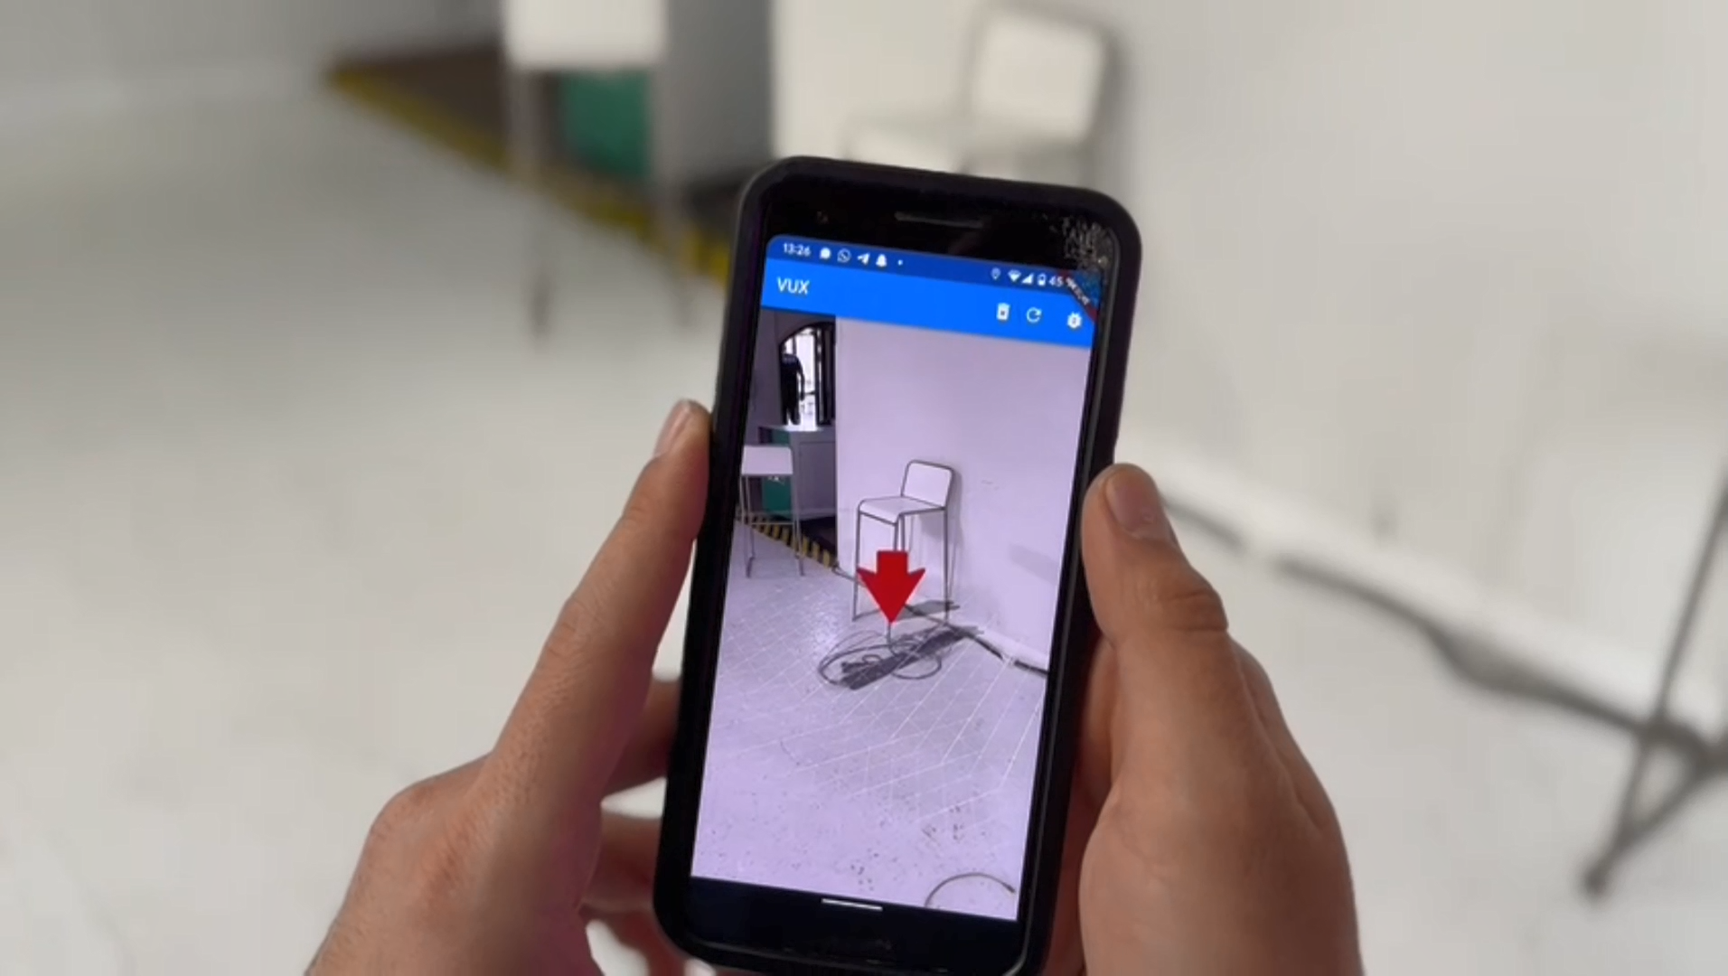

Slide 6







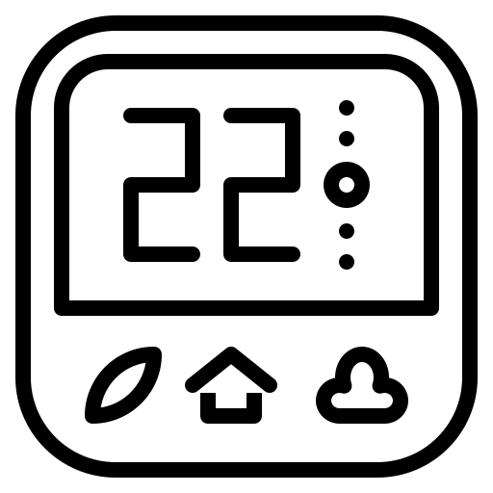


Tech Stack

Slide 7

Addressable Market
CAGR:
25.3 %
$ 570 B.
$ 93 B.
2030
2022
Global Smart
Buildings Market

Slide 8




UX Benefits
Be in charge of your building
Reduce personal
CO2 footstep
Get rewards

Slide 9
SMART BUILDING
UX SUCKS
IMPROVE IT WITH VUX

